Slide 1

Room Swappers
By Salem Bugshan, Saud Alshubaibi, Stefan Wong, Thomas Scrivanich and Mykel Turner

Slide 2
Login/Register page
When the user first opens the app, a page will pop up to ask for the login details
It shows the Login/Register process where the user has to login into his account or register a new one using an email and a password.

Slide 3
Registration
If the user is new, then he/she has to register in and the page will look as follows:
The user will be asked to enter his/her last name,the name of the building they are currently in and a password

Slide 4
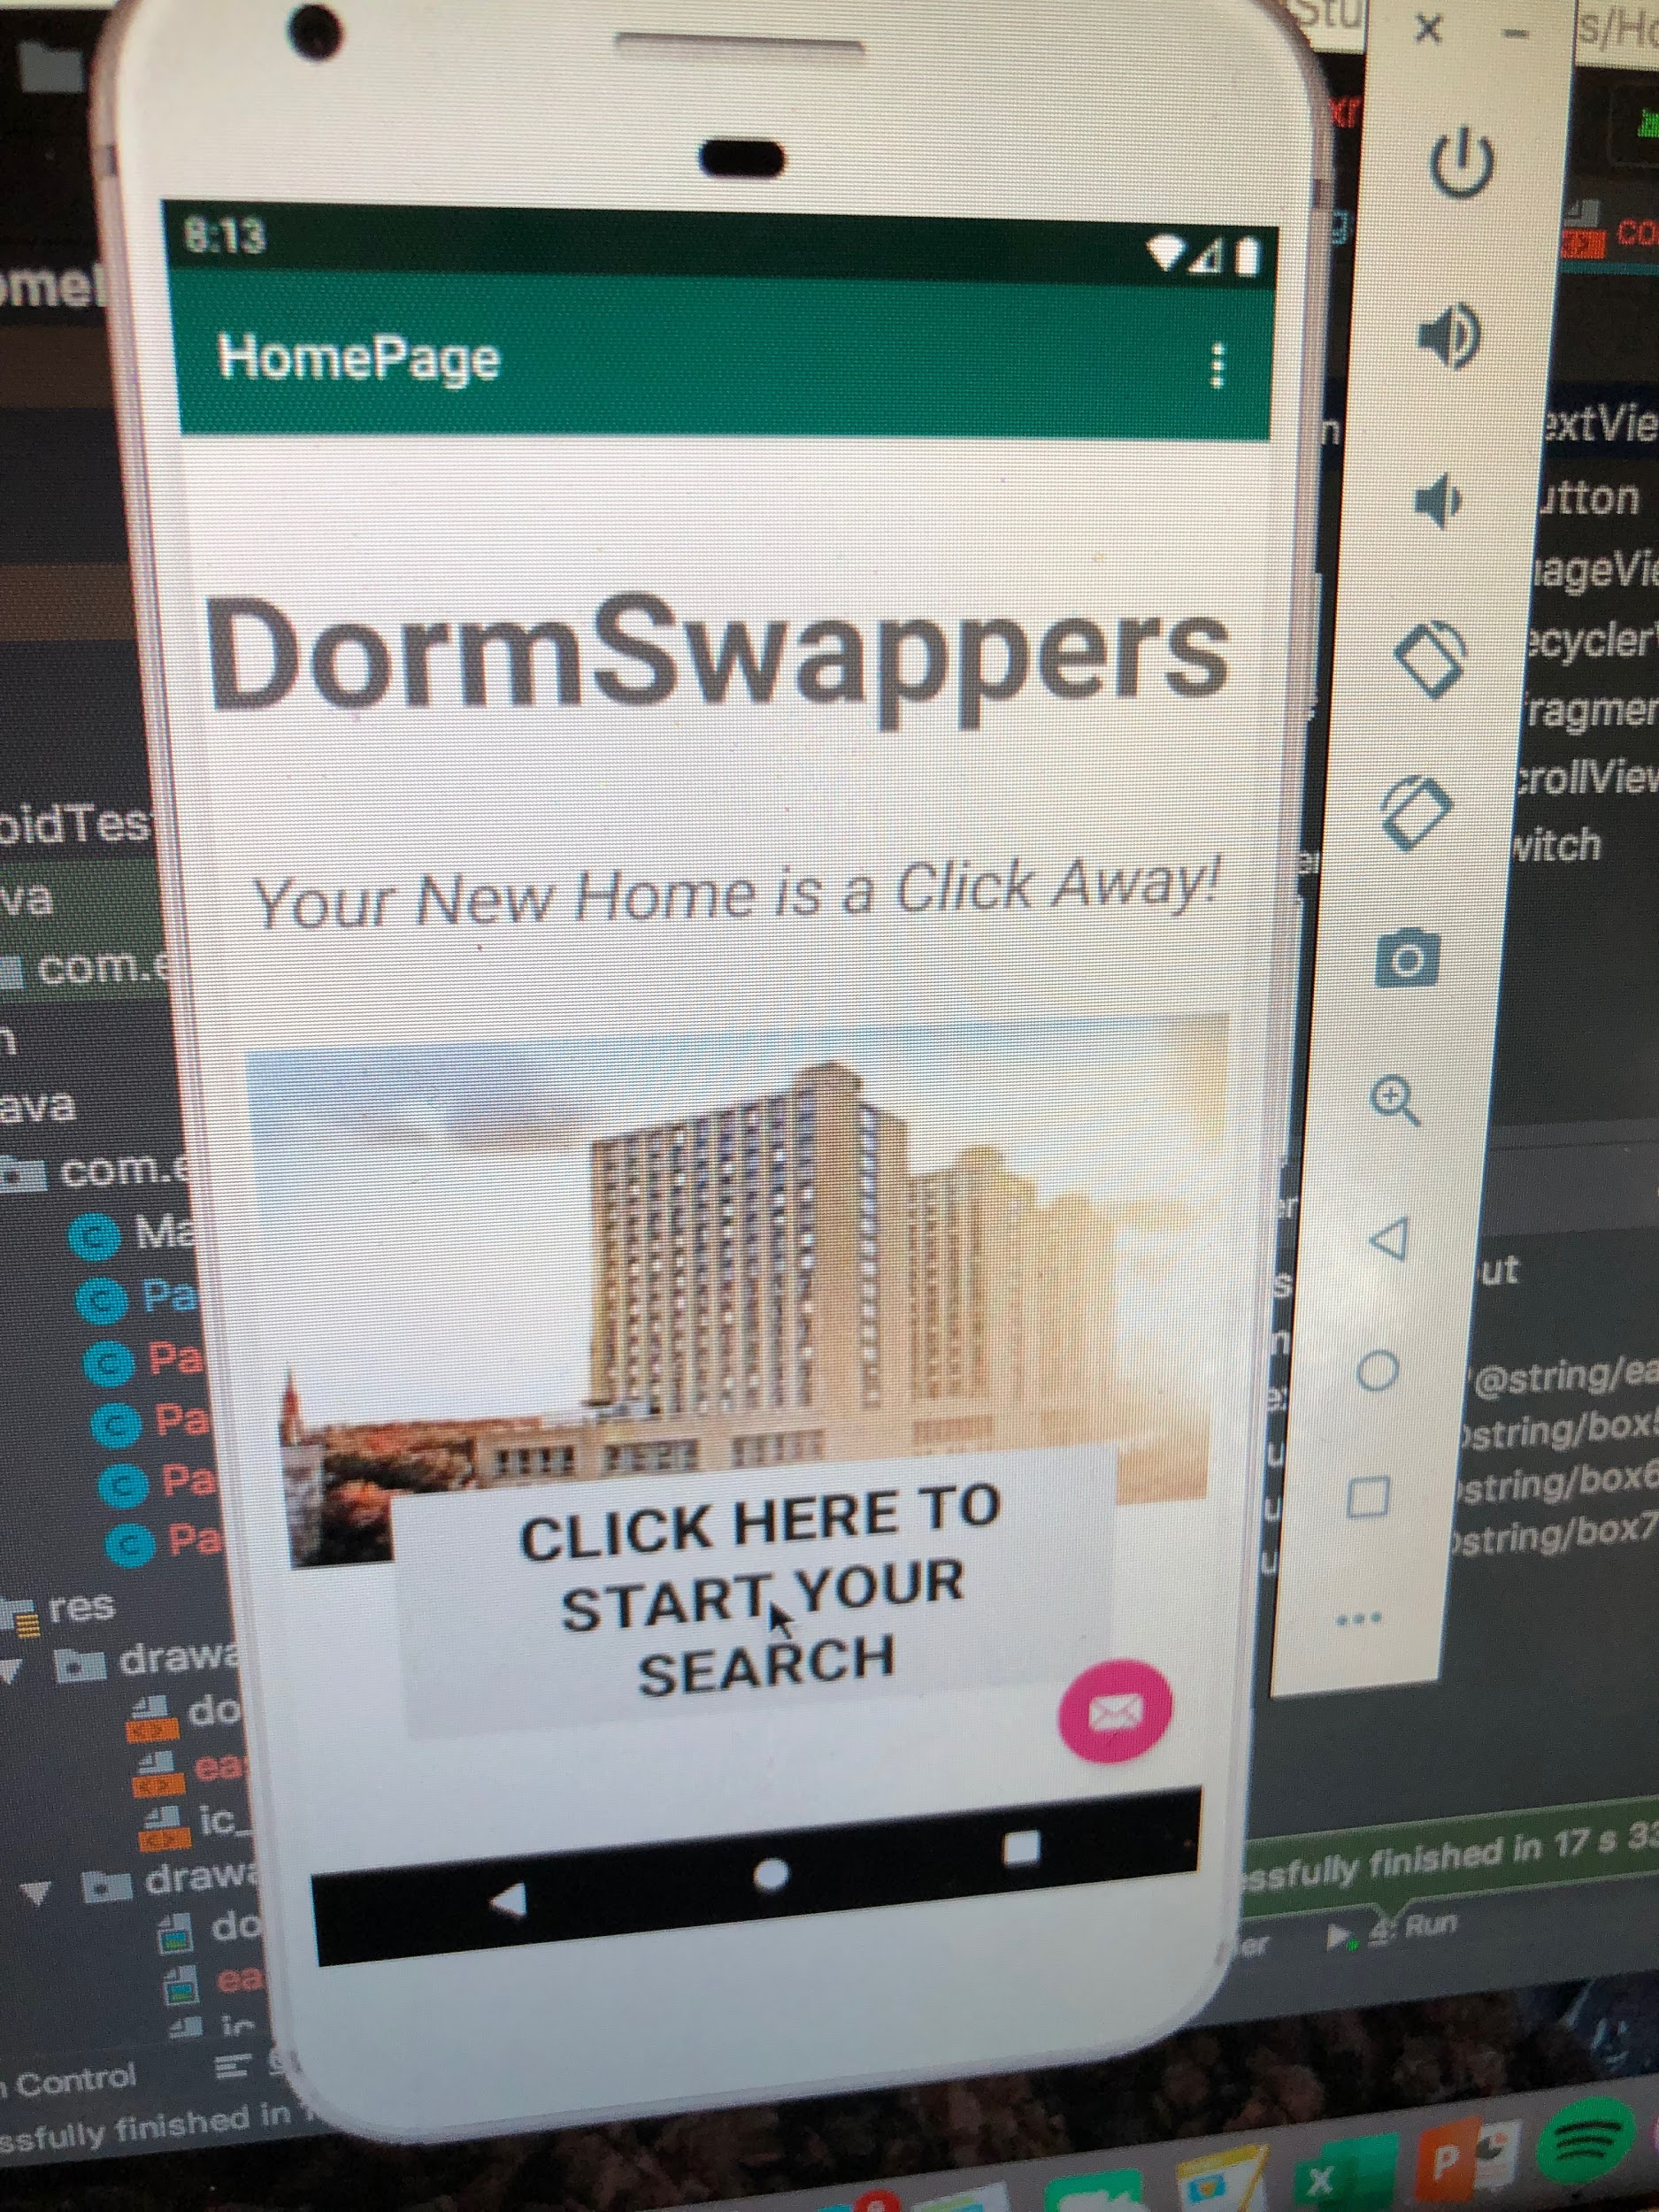
Main Page
This is the main page of the app after you login:
This main page just introduces our app and what it is called, if you click on the button it will take you through the process of room swapping.

Slide 5
Location Page
This page will allow the user to choose the exact location on campus.
The user can click on only one location that would have the buildings in that area. The options are East, West, Central and South. The page will be shown on the next slide.
After choosing the location on campus, the page will automatically change to show the available buildings.

Slide 6
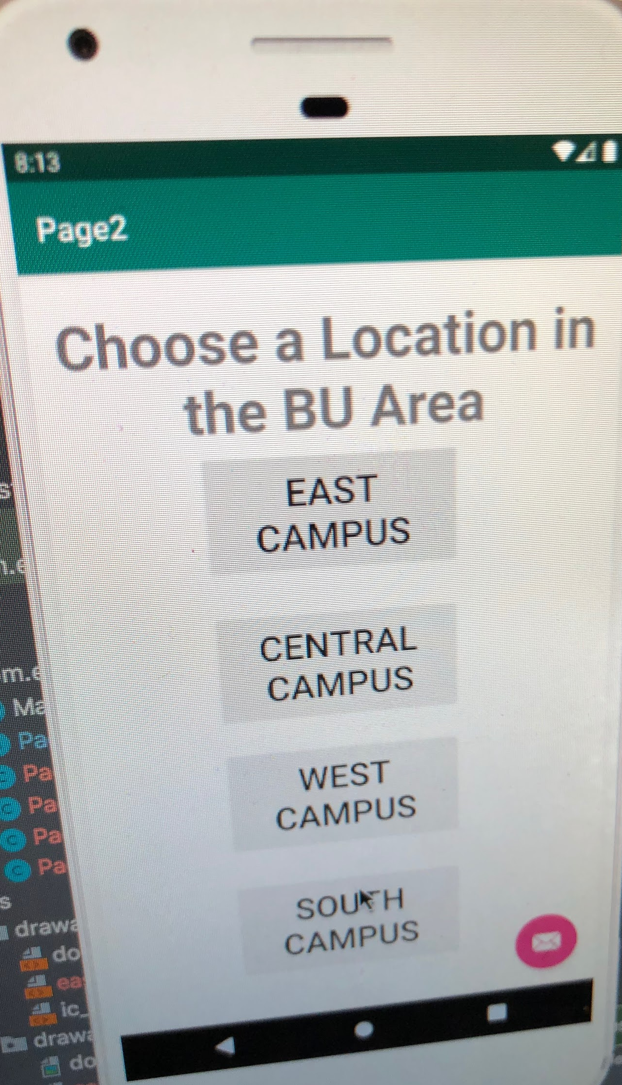
Location

Slide 7
Buildings
After choosing the location of the building e.g. East campus, a page that has the buildings will be displayed. The page will allow the user to choose the name of the building in the area.
Ex. East, Myles will be shown on the next slide.

Slide 8
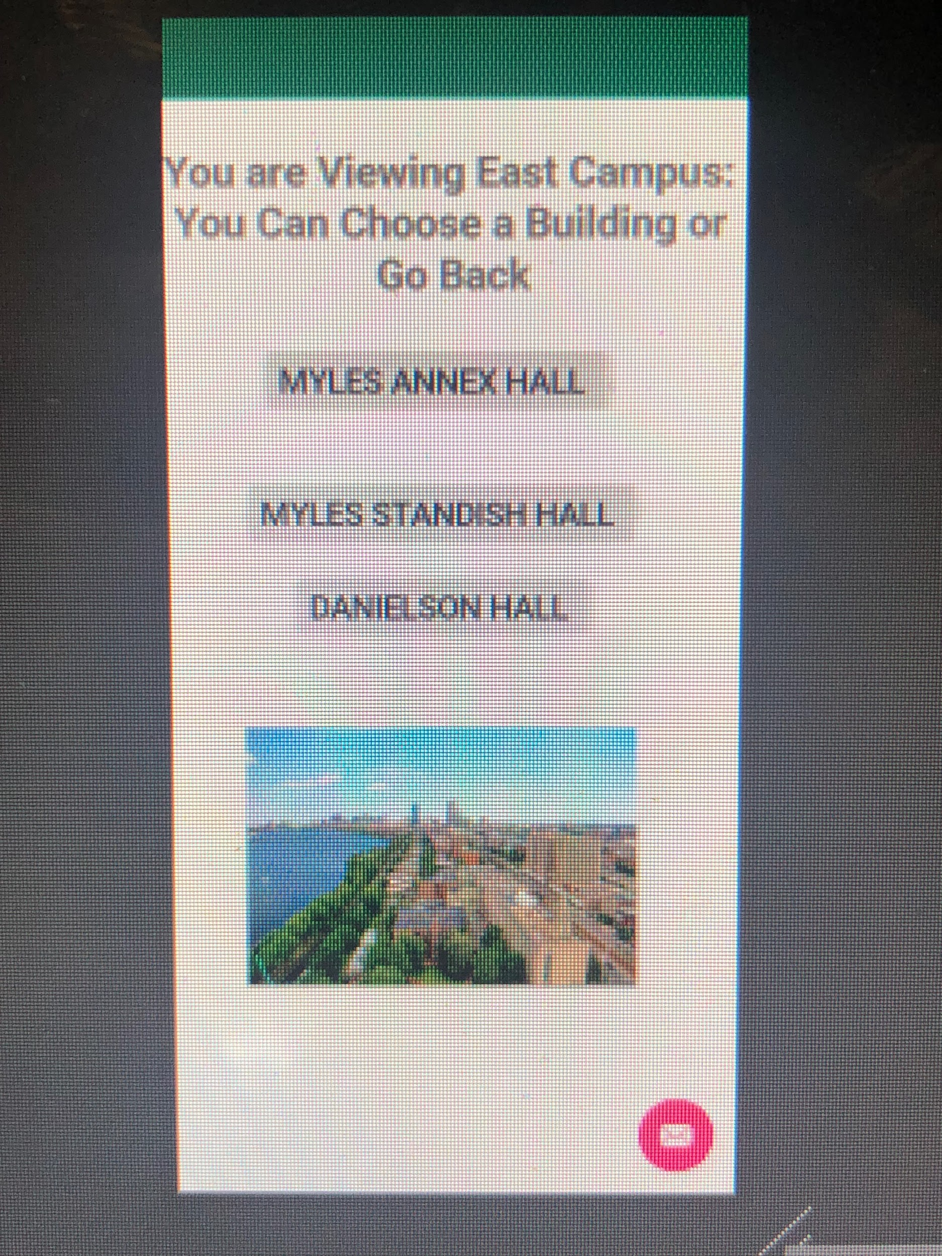

Slide 9
Final Information
The last page will provide the rooms for the exact building in the exact location.
The information available will include the available rooms and the names of the people living in the room from the database.
If the user would like to request the change, he/she can contact the person.

Slide 10
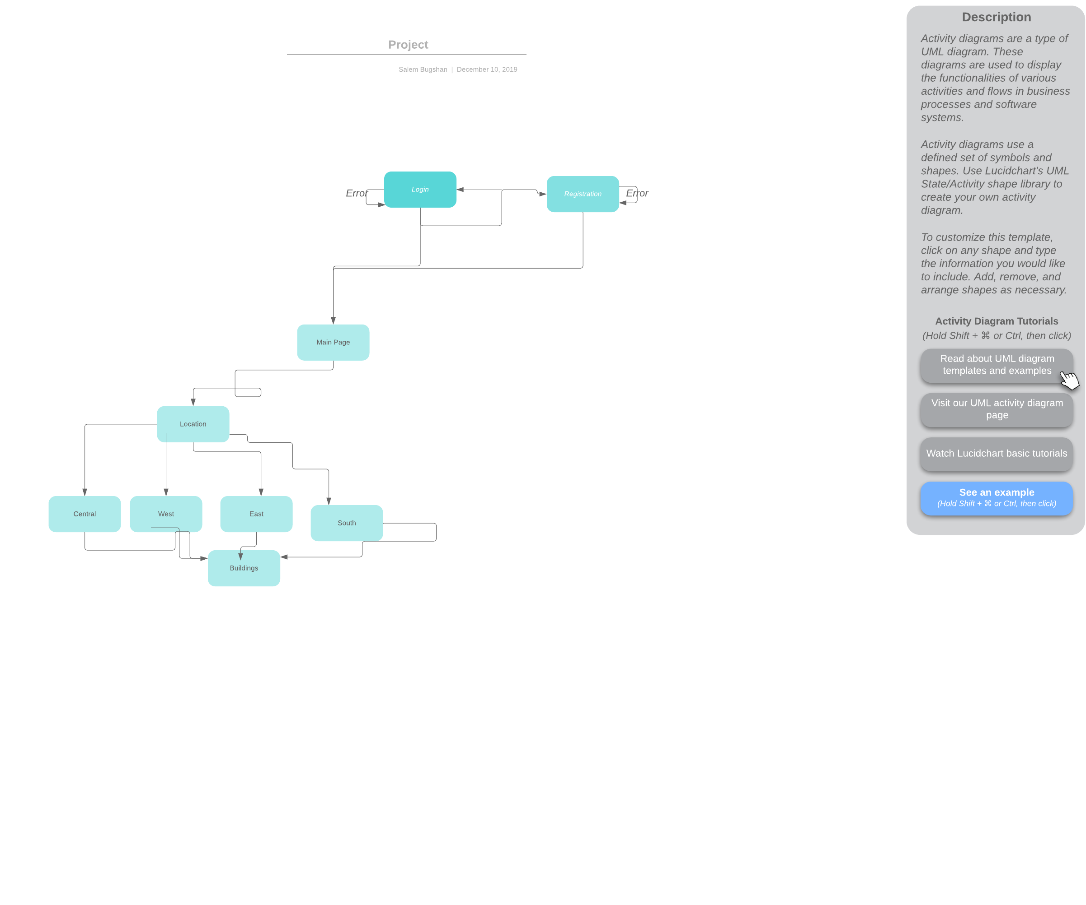
Flow Chart

Slide 11
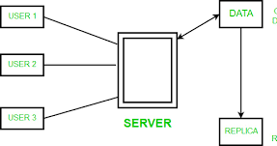
Overall software architecture description
The app is described thoroughly in the slides as it shows the transition from one stage to the other so that it is easier for the user.
The flow chart provides a design plan that describes the elements of the app. It is a pathway of what happens after each choice between classes.

